Slide 1
Mobile and Web Multimedia
CT009-3-2
Version VC1
Mobile Web Development

Slide 2
Topic & Structure of The Lesson
Introduction to different types of commercially available mobile applications
Introduction to Mobile Web
Introduction to XML
Markup Language – HTML/XHTML
Introduction to WML/WML Script
Software Available for development

Slide 3
Learning Outcomes
At the end of this topic, You should be able to:
Identify mobile web development technologies and solutions
Demonstrate the ability to build mobile web applications

Slide 4
Key Terms You Must Be Able To Use
If you have mastered this topic, you should be able to use the following terms correctly in your assignments and exams:
Mobile
Mobile applications
WML
Scripts

Slide 5
Introduction to Mobile Web
Is there a need for another web standard targeting mobile devices?
Desktop web development does not translate to the mobile world.
Mobile development requires
Lightweight media
Different Navigation methods
Streamline media options.
Desktop mark-up features does not really suit for a mobile environment.

Slide 6
Present Wireless Communication
WAP – Wireless Application Protocol.
Currently is version 2.0
Communication protocols that standardised the way mobiles can be used for Internet access
i-Mode
The first "smart phone" for Web browsing, first introduced in Japan; provides colour and video over
telephone sets and is becoming increasingly popular outside of Japan too.

Slide 7
What is WAP?
The de facto worldwide standard for providing Internet communications and advanced telephony
services on digital mobile phones, pagers, personal digital assistants and other wireless terminals.
Phone.com, Ericsson, Nokia and many others began developing independent standards
Made more sense to focus development around a common standard
Goal was to establish a common format for Internet transfers to mobile telephones across vendors and providers.
WAP is an application communication protocol
WAP is used to access services and information
WAP is for handheld devices such as mobile phones
WAP is a protocol designed for micro browsers
WAP enables the creating of web applications for mobile devices

Slide 8
WAP Problems
Devices are poorly designed and have a difficult user interface. Inputting text is a pretty clumsy business.
Mobile screens can only display a few characters
Reliable Wireless Networks - WAP gateways suffer from high downtimes and assuming that end-users do get through calls are dropped easily.
Lack of roaming across multiple networks
End-users still need to dial-up for a connection, and set-up times are long, which further frustrates end- users.
No Instant Connectivity
Its bandwidth is extremely limited

Slide 9
Connection to WAP
WAP essentially dial-up over mobile
Unreliable
Expensive
Slow
The connectivity of mobile devices for both phones and PDA’s have improved.
GPRS
EDGE
UMTS
3G, 3.5G & 4G (Offers High-Speed Access)

Slide 10
GPRS
General Packet Radio Service
GPRS provides the always-on experience which means that end-users can choose to be in ‘receive-mode’ and/or ‘send-mode’ all the time, wherever they are.
GPRS still operates in the GSM frequency bands.
Data traffic will compete with voice traffic on the GSM network

Slide 11
EDGE
EDGE Technology is a further development of current GSM networks.
Enabling a maximum speed of 384kbps.

Slide 12
UMTS
UMTS has access to new frequency bands and significantly more capacity to carry both voice
and data traffic.
Congestion issues will no longer be significant.
UMTS speeds will be higher than on GPRS and more consistent too, because competition
between traffic streams will be less intense.
The quality of the transmission will be higher as well leading to a much richer service
environment.

Slide 13
3G / 3.5G / 4G
Proved expensive with limited coverage
Possibility of up 1mbps, more likely 384kbps
4G may be here before 3G picks up speed
Both technologies have the possibility of delivering content at over 1mbps to a mobile device
True multimedia experience on the move

Slide 14
3G
The slow growth put down to the delays in launching 3G service by many operators
Cite financial and technical difficulties
Bandwidth problems, no mass sites
Problem sourcing handsets as it’s costly
Most current Malaysia operators offer 3G services
Limited service to large cities (Kuala Lumpur, Penang, Johor Bahru)
All operators are under pressure to start recouping some of the billions of investment made in the 3G licenses

Slide 15
The Need For Mobile Web
Ubiquity
Fulfils the need for real-time communication and information anywhere.
Instant Connectivity
Achievable using GPRS and better
Personalisation
Personalized interface and information
Intelligent browsing – knows your preferences before you use it
Localisation
Knowing where you are

Slide 16
Introduction To XML
XML is a huge part of web development
Used to define documents
Used to define data types
Cross platform compatibility - structured plain text
XHTML is an XML document
WML is an XML document

Slide 17
Markup Language
A mark-up language adds structure to a document
Contains codes to define structure
<h1>Heading Text</h1>
<h2>Second Heading</h2>
<p>Paragraph text - the cat sat on the mat</p>
XHTML
eXtensible Hypertext Mark-up Language
Used for desktop web site development
Used on some recent PDA devices
XHTML is HTML defined as an XML document.

Slide 18
WML
Wireless Mark-up Language
WML is designed for mobile devices
WML is an XML document just like XHTML
Unlike XHTML, a WML document contains many ‘cards’ that a mobile device can display
An XHTML document tends to contain <body> </body> to contain document contents
Pages in WML are called Decks
A deck is a set of cards

Slide 19
A Deck of Cards
<wml>
<card>
<do type="accept" label="next">
<go url="#card2"/>
</do>
acme inc.<br/>directory
</card>
<card name="card2">
<do type="accept">
<go url="?send=$type"/>
</do>
services
<select key="type">
<option value="em">email</option>
<option value="ph">phone</option>
<option value="fx">fax</option>
</select>
</card>
</wml>
Acme Inc.
Directory
_____________
Next
Services
1>Email
2 Phone
____________
OK

Slide 20
WML Input
First Name:
Jane_
____________
Next
Last Name:
Doe_
____________
Done
Back
Accept
Prev
<card>
<do type="accept" label="next">
<go url="#card2"/>
</do>
first name:
<input key="fname"/>
</card>
<card name="card2">
<do type="accept" label="done">
<go url="?get=person" method="post"
postdata="first=$fname&amp;last=$lname"/>
</do>
last name:
<input key="lname"/>
</card>

Slide 21

Graphics WML
WBMP Stands for Wirelss WBMP
It is default and only supported picture for WBMP
WBMP’s are uncompressed, monochrome black/white bitmaps intended for use in devices with small screens and narrow bandwidth connection.
You can convert gifts to WBMP using on-line resources.

Slide 22
WML Editors & Emulators
Editor
Nokia ToolKit
Notepad
Coffee Cup Wireless Web Builder.
3TL Wbuilder Professional
Openwave
Microsoft Web Matrix
Emulators
M3Gate
UPSDK
Openwave

Slide 23
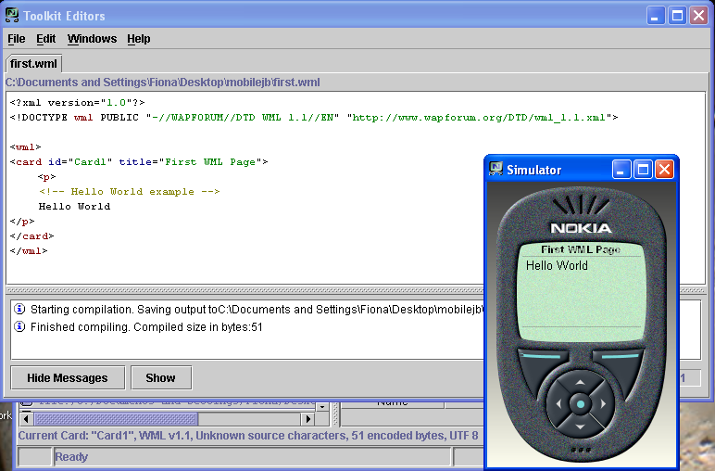
Nokia Toolkit

Slide 24
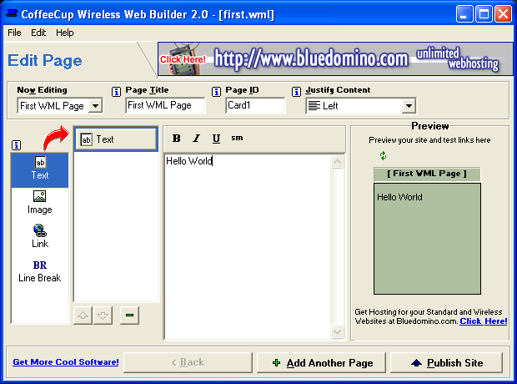
Coffee Cup

Slide 25
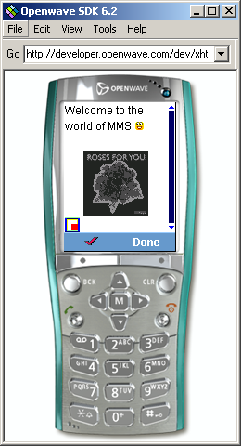
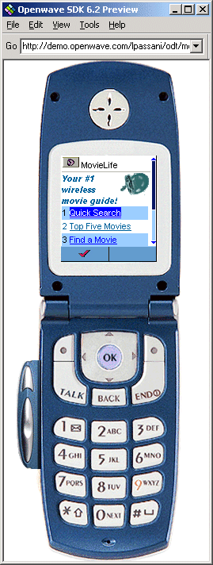
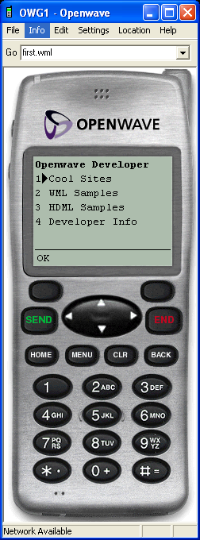
Openwave

Slide 26
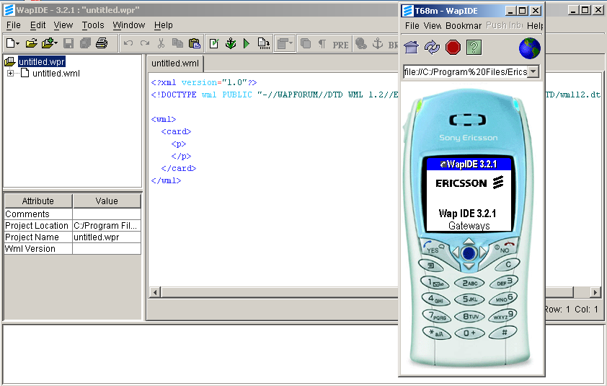
Ericsson Toolkit

Slide 27
Web Standards
World Wide Web Consortium @ www.w3c.org
Sets the standards for the web
Provides vendor neutral forum for its members to address web related issues
W3C has over 510 Members and nearly 60 full-time staff around the world who contribute to the development of W3C specifications and software.

Slide 28
Why Standards
Standards are a good idea
Developers write standard mark-up
Browsers display standard mark-up
Users do not have to concern themselves over which browser to use
Differences between browsers should be in the application use
Not which web sites a browser can view
Defeats the point of the World Wide Web

Slide 29
What Are The Standards ?
There are many W3C standards
More accurately – “Recommendations”
Define the structure and syntax of document types on the web
The move towards XML as a standard base application for documents
There is no way of policing these standards
Web site creators have traditionally had free reign to do what they want and as such it does not help the web progress.

Slide 30
Web Standards ?
Ideally XML is the key technology
XML is highly versatile when used with related technologies
XSLT, XPATH
eXtensible Style sheet Language Transformation (XSLT)
Can be used to convert any XML document into a different format
E.g. XML data to XHTML
XHTML to WML

Slide 31
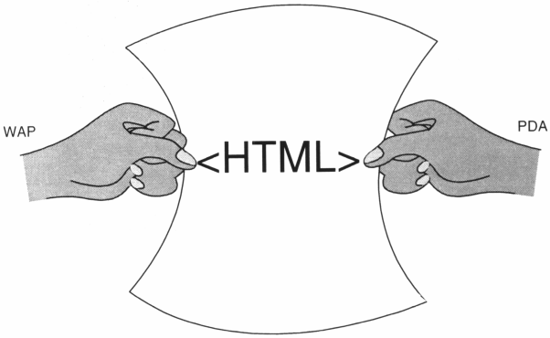
Real World

Slide 32
Real World
XSLT requires processor power
Ideal is not suitable on all current devices
We create more standards
Different devices use different mark-up
Different devices show one type of mark-up differently
However, legislation has been introduced to make the web accessible to everyone

Slide 33
Web Standards
Who is responsible
Designers
Developers
Software Manufacturers
Users?
Why should users care?
Do they care?
Will they / should they have to?

Slide 34
Device Characteristics
Web standards sound great.
Construct a site to standards.
Have a standards compliant browser render it flawlessly regardless of platform or device type.
Why did we not do this from the start and neither we do not do it now.

Slide 35
Device Characteristics
A truly standard World Wide Web is something that we all should aim for and in the mean time
Devices are getting better – but not perfect
Older sites do not convert
Means nothing to the ‘man on the street’
Different devices require different design and implementation
Until we become fully standards compliant this will not change

Slide 36
Device Characteristics
Let us examine various devices and highlight there characteristics
As designers and developers we must take into account the devices that are likely to be used
We wish to discount as few people as possible
Why limit your audience with poor design?

Slide 37
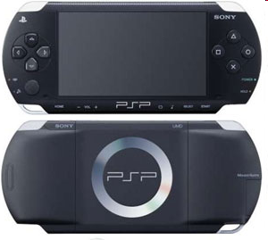
Playstation Portable
11cm / 4.3in Screen
16:9 Widescreen
480x272 resolution
Browser: Mozilla 4.0
Popular gaming device
Wireless access capability
The most recent update of the PSP firmware supports HTML, JavaScript and Apple PodCasts
Relatively fast and powerful
Slower than a desktop
Limited version of XHTML compliancy supported
No Flash player

Slide 38
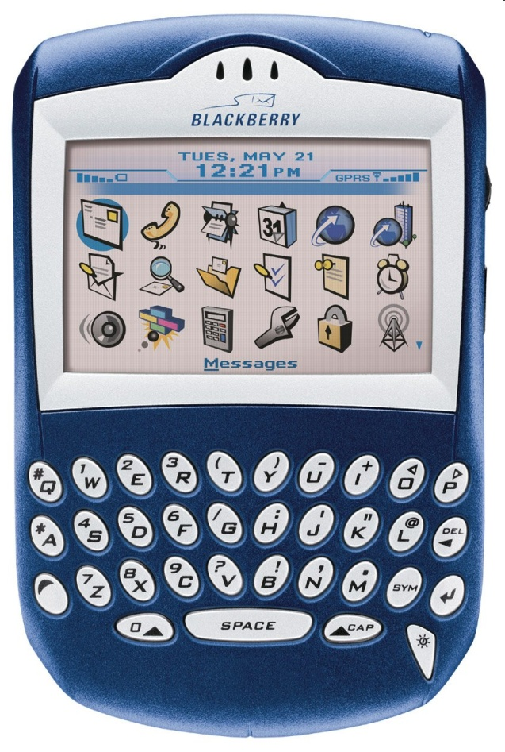
Blackberry Device
240x160 (BlackBerry 7520)
Browser: BlackBerry/3.6.0
BlackBerry Features:
Basic HTML support
Scripting support (JavaScript)
WML and WML Script
Internet and e-mail access

Slide 39
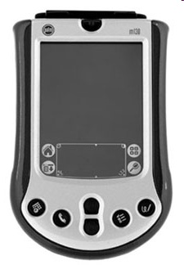
Palm OS Device
Screen: 320x480 colour screen
Various browser agents:
IE
Netscape
Palm
Standards compliant
HTML
xHTML
cHTML
WML, SSL
JavaScript
CSS
GIF and Cookies too

Slide 40
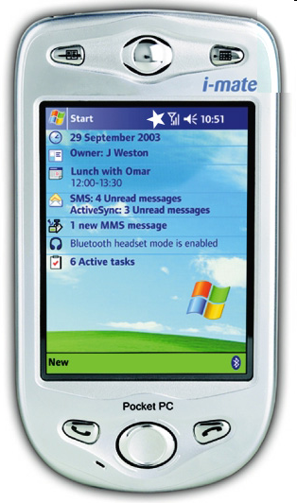
Windows Mobile (PDA)
240x320 resolution
640x480 high end
Full colour displays
Multiple connectivity options
Compatible with XHTML
Subset of XHTML
Does not fully support the whole standard
Versatile, performing many functions

Slide 41
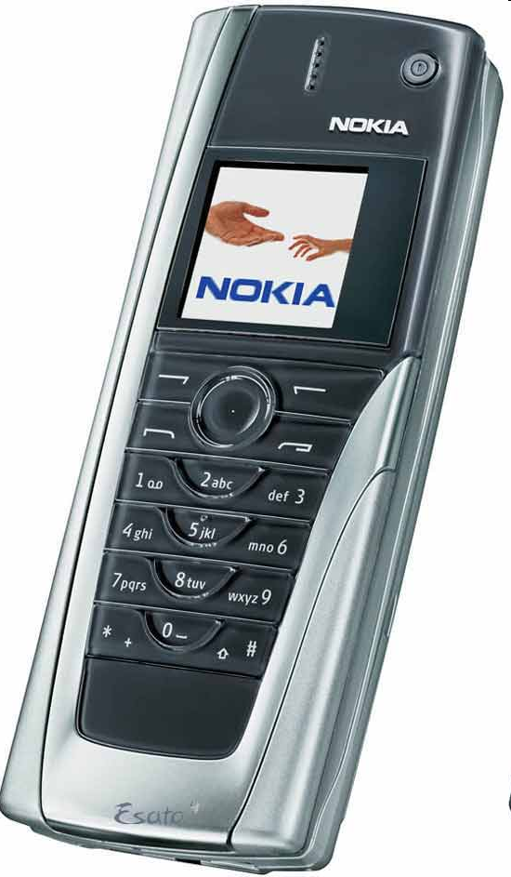
Symbian
Varying screen size
Not generally limited to a design type
Symbian is an operating system
Mostly used for cellular phones
Best standards compliancy
Opera web browser

Slide 42
Question and Answer Session
Q & A

Slide 43
What we will cover next
Mobile Multimedia

